Slide 1
From Diagnostics to Policy Questions
Lisa Kolovich, IMF

Slide 2
Your task as policymakers:
Diagnose key underlying barriers that affect women’s economic participation.
Identify which reforms are essential to tackling the barriers.
Analyze which reforms might yield the highest returns and which ones would gather broad support.

Slide 3
A quick recap…

Slide 4
Distributional Channels and Macroeconomic Outcomes
Helpful Resources:
IMF Strategy Toward Mainstreaming Gender
Integrating Gender into Macroeconomic Policies at the IMF
GDP gains and Productivity
Greater financial stability
Economic diversification
Inequality
Legal rights, education, health, financial inclusion
LFP, wages,
representation/
leadership
Macro Outcomes
Economic growth and resilience,
macro-financial stability
Policies
fiscal, monetary, structural, financial

Slide 5
Why can increasing women’s economic participation boost GDP?

Slide 6
Let’s look at GDP through the demand side:
Y = GDP = C + I + G + (X – M)
Output: Traditional measures of GDP exclude non-market transactions; thus, women’s unpaid care work and subsistence work are not counted
Consumption: Micro evidence shows that who controls income can change household spending priorities—often increasing allocations toward children’s health and education
Investment: Investment patterns in male-run businesses are different from those of female-run businesses.
Government: Women and men often have different needs for public expenditure and are impacted differently by taxes.
Net Exports: Inequality in export value added contributions and employment in tradable sectors.
Notes:
GDP from factor sides:
Y = GDP = W + R + π
Wages: gender gaps in wages are well-established, as well as gender bias in hiring and promotion
Rents: Property is unequally distributed between women and men and so rents are gendered
Profits: Gender biases in corporate ownership are well-established

Slide 7
Other factors to consider...
Productivity is affected by gaps between men and women such as in:
education
health
legal protection
access to childcare
house chores, elderly care and other unpaid work
These factors generate misallocation of workforce across the economy, lowering aggregate productivity.

Slide 8
Boosting FLFP is critical for sustainable and strong growth and can amplify the impact of structural reforms
Output gains from Major Historical Reforms
(% of output)
Average for EMDEs:
23 percent
Source: The first four columns are from WEO (IMF, Oct. 2019, Ch. 3), model simulated, based on actual reforms. The fifth column is based on Ostry and others (2018), updated by staff assuming all countries reduce gender gaps in line with what the top 5% best performing countries achieved during 2014-19.
Source: Ostry and others (2018). Based on 128 countries. For gains be realized, various frictions such as financial barriers and informality would need to be addressed, requiring both broad macro-structural reforms and reforms to specifically tackle the frictions that hinder the closing of the gender gaps.
3.
Notes:
This slide presents the gains from structural reforms and from closing gender gaps in labor force participation, based on feasible scenarios in both areas.
The first four columns in the left chart show the sizable model-based gains from major structural reforms, based on actual reforms, as published in the 2019 October World Economic Outlook.
The last column in the left chart presents the model-based gains from reducing gender gaps using the methodology presented in a 2018 Staff Discussion Note. The results suggest that reducing gender gaps in line with the average decrease seen in the 5 percent of countries that saw the largest gender gap reductions between 2014 and 2019—that is mirroring a reasonable medium-term change—could yield an average GDP gain of 7.7 percent.
The chart on the right illustrates the potential GDP gains from closing gender gaps in labor force participation in 128 emerging and developing economies, a longer-term scenario. The GDP gains from such a decrease could reach 23 percent on average. For it to be realized, frictions such as financial barriers and informality would need to be addressed, requiring both broad macro-structural reforms and reforms to specifically tackle the frictions that hinder the closing of the gender gaps.
Structural reforms are therefore critically important and necessary for growth and improved gender outcomes. At the same time, structural reforms designed without a gender lens are unlikely to be sufficient to reduce gender gaps, and a gender lens can amplify the positive impact of structural reforms on growth. This calls for a systematic and intentional approach to integrating gender into reform design.

Slide 9
Estimates in IMF country work show sizeable long-run gains from higher FLFP
Outcomes:
Reducing gender gaps could increase GDP per capita growth substantially:
Mauritius: 0.8 percent per year if gap closes to OECD LFP average
Angola: closing human capital gaps could increase real GDP growth rate by 0.2 percentage points per year
Core Channels:
Higher potential growth through larger effective labor supply and better talent allocation
Higher productivity as firms draw from the full skills pool (not just half)
More resilient households: women’s earnings reduce poverty and smooth shocks
Demographics: low participation becomes costlier as working-age populations slow or shrink
As policymakers, consider structural policies to address barriers and boost women’s economic participation.

Slide 10
Identifying and Designing Policy Measures
Notes:
Let me start with the drivers of gender inequality.

Slide 11
Sources of Legal Impediments
Selected Policies for Women’s Economic Empowerment
Legal reforms
Fiscal policies
Financial sector policies
Policies matter despite social norms:
Constitutional law and civil rights
Family law
Property law
Strategic budgeting
Access to digital infrastructure (mobile phones, high-speed internet, digital ID)
Labor market policies
Recruitment, promotion and retention policies
Labor law
Tax law
Direct/indirect taxation
Spending on education, health, infrastructure and well-targeted social assistance
Training and skills enhancement
Public sector wage policies
Parental leave and child/elderly care
Supervisory guidance
Investing in digital and financial literacy
Taxation
Childcare
Parental leave
Education
Family allowances

Slide 12
Legal Reforms
Notes:
Let me start with the drivers of gender inequality.

Slide 13
Macroeconomic gains from legal reforms
Women’s property rights and legal capacity over 50 years shows that reforms expanding women’s rights and legal protection were associated with…
Increased movement out of agricultural employment for women,
Larger shares of women in wage employment.
Higher female labor force participation,

Slide 14
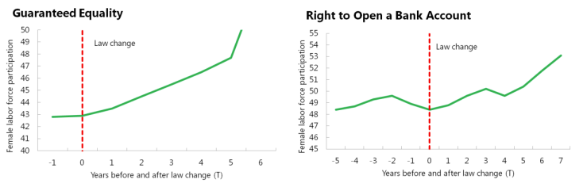
IMF research points to increases in FLFP after legal reforms.
Fair Play: More Equal Laws Boost Female Labor Force Participation (imf.org)

Slide 15
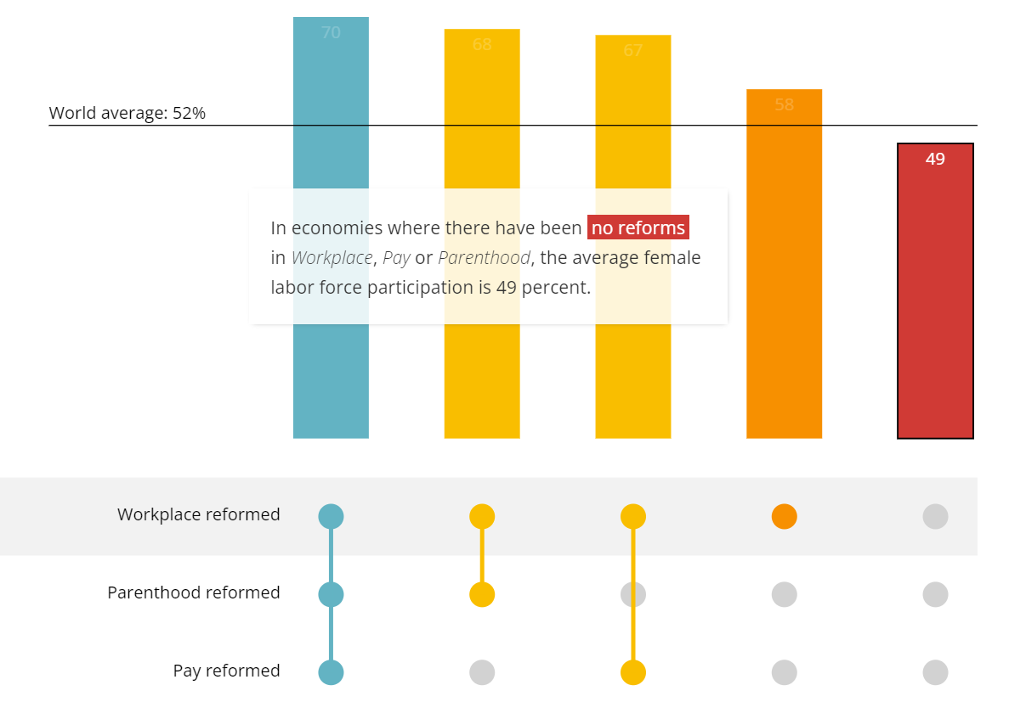
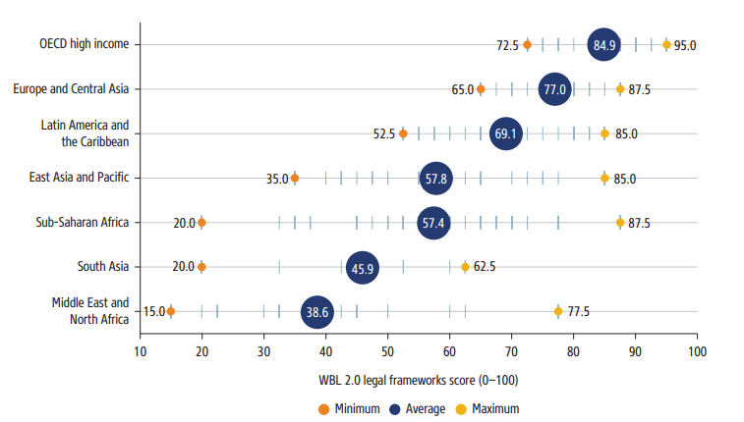
FLFP is higher in countries with supportive legal reforms.
Helpful Resources:
Snapshots V2
Reforms
Sources: Gender equality: Legal progress towards gender equality (worldbank.org) and Women, Business and the Law 2024

Slide 16
Sources of Legal Impediments
Constitutional Law & Civil Rights
Family Law
Property Law
Tax Law
Legal rights related to citizenship, right to vote, freedom of movement
Political participation
Access to justice for women
Legal age of marriage
Ability to run/head households
Rights to divorce/end marriages
Ability to collect, own, manage and transfer assets
Inheritance laws
Labor Law
Access & distribution of property during or after marriage
Legal restrictions to work
Equal pay
Parental leave and childcare rights
Discriminatory tax burdens
Tax and subsidy incentives that increase women’s participation in the labor market
Notes:
Here the focus is on areas of law that have a direct impact on the economic participation of women, which are often interdependent
In other words, there are five areas of law that may limit women’s economic opportunities and may therefore offer opportunities for more empowerment.
These include:
constitutional law, such as the right to vote, freedom of movement, political participation and access to justice,
family law, including the marriage age, the right to divorce,
property law regarding ownership and distribution of property and inheritance,
labor law, including restrictions on where women can work , aws against discrimination and harassment in the workplace, parental leave and access to child care.
Tax law, including subsidies and tax incentives to increase female labor force participation.
Examples:
Family law:
46 countries still restrict women’s right to obtain a divorce
57 countries do not recognize the value of non-monetary contributions
Labor law:
66 countries still mandate that women retire earlier than men
In 65 countries women cannot work in an industrial job in the same way as man.
72 countries do not provide a paid leave of at least 14 weeks to mothers.
30 countries still do not have legislation that prohibits discrimination in employment based on gender

Slide 17
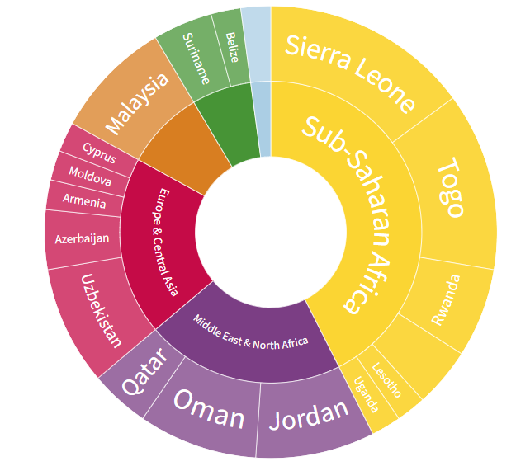
Select IMF country reports with a focus on legal barriers and women’s economic participation; WB resources
Kenya: Enforcement of labor laws and anti‑discrimination provisions to improve women’s access to formal employment.
Rwanda: Legal and institutional frameworks, including gender‑responsive budgeting mandates, supporting women’s economic participation.
Tanzania: Legal constraints affecting land ownership, formal employment, and productivity for women.
Uganda: Legal and regulatory barriers to business formalization, property rights, and access to finance for women‑owned firms.
Explore data on legal barriers: World Bank’s Women, Business, and the Law Report
Country snapshots: Snapshots V2
WBL 2024: Top Performers by Region

Slide 18
Fiscal Policies
Notes:
Let me start with the drivers of gender inequality.

Slide 19
Fiscal policies
Review and amend tax code
explicit and implicit distortionary taxes
negative effect of progressivity for secondary earners
Introduce gender budgeting
Design gender-responsive expenditures
invest in child and elder care
incentives for women in STEM
Invest in digital infrastructure and render it accessible to teleworkers
Helpful Resources:
Engendering the Recovery: Budgeting with Women in Mind
Gender Budgeting Is More Widespread But Implementation Remains a Challenge
Exploring the Role of Public Expenditure in Advancing Female Economic Empowerment and Gender Equality
Gendered Taxes: The Interaction of Tax Policy with Gender Equality
The Digital Gender Gap

Slide 20
Fiscal policies (continued)
Reduce inefficiencies in tax administration
Align public employment and wage policies with strategic objectives
Reform subsidies and transfers
simplify tax registration and filing for micro and small enterprises
expand digital tax services to lower compliance costs
improve access to formalization for women-owned businesses
targeted cash transfers
design social assistance to better reach women and female-headed households
consider public sector employment and career progression
assess impacts of wage bill and employment reforms
Helpful Resources:
Kenya: role of expanded social protection, improved targeting of transfers, and investments in childcare and transport access to support FLFP and inclusive growth.
Rwanda: Targeted social spending and a dynamic social registry to reduce inequality and support women’s economic participation, especially in the informal sector.
Cross-country: childcare spending, well‑designed transfers, and tax policy reforms can raise female labor supply and improve macro outcomes.

Slide 21
Financial Inclusion and Financial Health
Notes:
Let me start with the drivers of gender inequality.

Slide 22
Financial inclusion serves as a catalyst for economic growth, reducing poverty and inequality
Ensuring access and use of financial services to a broad spectrum of society, especially under-served groups including women; thus, enabling them to benefit from and contribute to economic growth.
Helpful Resources:
Emerging Trends in National Financial Inclusion Strategies
that Support Women’s Entrepreneurship
IMF Financial Access Survey
The Global Findex Database 2025
Providing individuals and businesses with access to capital, allowing them to invest in education, healthcare, and income-generating activities.
Helping underserved groups smooth their consumption, manage their financial risks, and invest in the future – thereby reducing poverty and inequality.
Notes:
Inclusive growth involves the fair dissemination of economic gains and the generation of opportunities accessible to everyone.
Therefore the impact not only on reduction of poverty but also of INEQUALITY is highly relevant
It provides a broad spectrum of society, especially under-served groups including women, low-income households and small businesses, the access and use of financial services, thereby enabling them to partake in the fruits of economic growth, spurring entrepreneurship, innovation, and job creation
Financial inclusion fuels economic expansion by enhancing savings and investments, Providing individuals and businesses with access to capital, allowing them to invest in education, healthcare, and income-generating activities.
Reliable and affordable financial services, such as savings, credit, and insurance, empower society, particularly the underserved or excluded, to invest in their futures, manage consumption efficiently, and handle financial risks more effectively. This, in turn, can lead to improved income levels, potentially reducing poverty and inequality.
Inclusive growth. The concept of inclusive growth is founded on the principle that wealth generation, economic liberty, and equal chances can coexist (Agarwal R.). The OECD (2018) describes it as growth that is evenly distributed throughout society.

Slide 23
Financial Health
Financial Health: measuring financial well-being outcomes
Financial health implies that individuals and households can
There are different variables that can reflect the state of an individual’s financial wellness
Manage everyday expenses
Withstand and recover from shocks
Progress towards financial goals
Exercise control and feel secure about finances
Liquid assets, such as cash and deposits
Wages and salaries
Gross disposable income
Debt service payments
Financial assets, such as debt securities
Household savings
Current transfers, such as tax credits
Insurance, such as medical and life plans
Short-term credit
Net worth
Nonfinancial assets, such as real estate
Household debt, including mortgage
Credit card use and balances
Foreign exchange assets and liabilities
Insurance,
Pensions
Nonperforming loans
Refinancing activity
Digital payments
Notes:
Beyond financial inclusion, the outcome of “good financial inclusion and policies, enabling inclusive growth
Complex task to acquire data.
From a macroeconomic perspective we see value on supply-side data t support such measurement
Compiling complementary data bases, FAS, FSIs and MFS HH sector
+ Developing new data dimensions

Slide 24
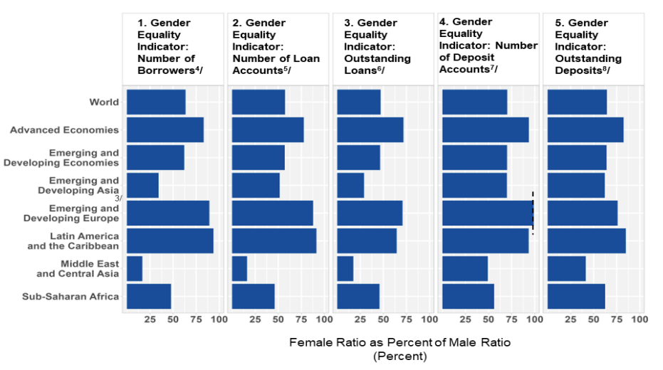
Regional variation in access to finance
Source: IMF Financial Access Survey

Slide 25
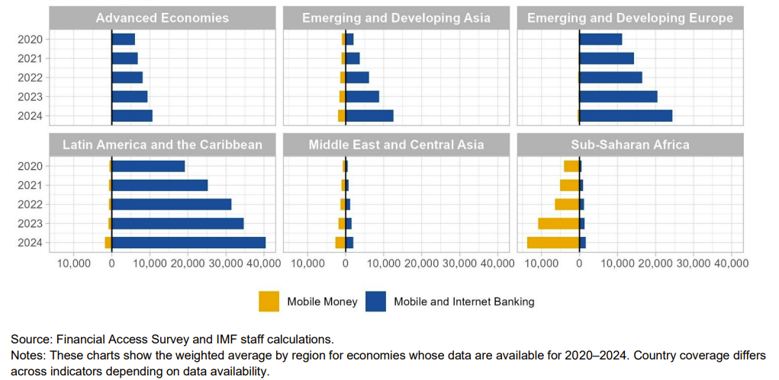
Mobile money is playing a transformative role in expanding access to finance in SSA.
FAS

Slide 26
Policies to boost access to finance
Financial Inclusion
Provide incentives to banks to promote financial access
Develop wireless payment systems
Build alternative credit verifying channels
Reduce legal barriers to owning an account
Universal official identification systems
Access to digital financial services
Direct deposit transfers, payments
Financial literacy programs
See IMF Financial Access Survey (FAS) for country examples and disaggregated data

Slide 27
Questions for discussion:
Are there policy reforms in your ministry or agency that could yield results?
How can you work within your own ministry/agency to address women’s economic participation?
Can you collaborate with other ministries and organizations to i) identify challenges and barriers to women’s economic participation and ii) design policies to address them?
Notes:
Let me start with the drivers of gender inequality.

